Slide 1
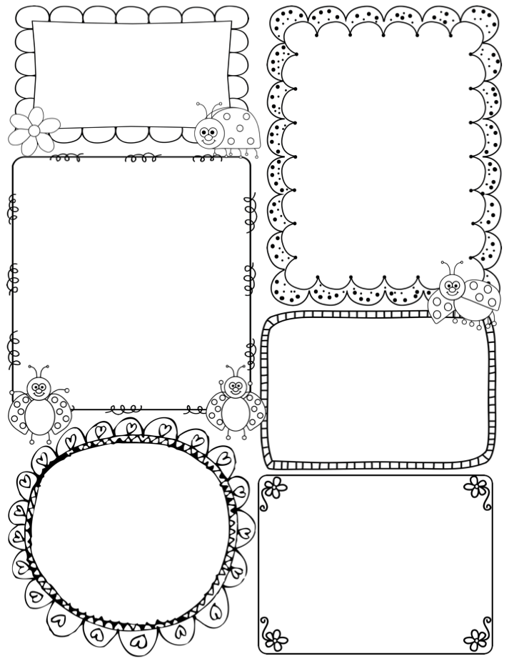
Ambitious Otters
Newsletter
Week of: 2/22/16
Important Dates:.
* All Pro Dads Breakfast is on March 4th
*Spring Pictures are March 8th
Spring Concert for first grade is on March 16th. More information will be sent home from the music department
.
I have moved our class website TO http://mrsbbyrdsclass.weebly.com
* I AM WORKING ON ADDING MORE ITEMS TO OUR SYMBALO PAGE AS WELL AS UPLOADING PICTURES.
In Reading…
Learning Goal: I can describe connections between two pieces of information in a text.
Students need to find connections between things in a non-fiction text. Think sequencing steps in a story! (first ,next, then, last)
Phonics Skills: igh, ie, y(all long I)
Examples: pie, night, cry
Power Words: pretty, pull, read, write, school
In Math…
Learning Goal: I Can compare 2 digit numbers using symbols >,<,,=
Students will need to be able to use the symbols to compare the numbers and discuss how the are greater (example, 64 has 2 more tens then 44).
In Writing…
Learning Goal: I can write an Informational piece explaining how to do something
Students will be writing a how to piece on how to grow a plant (Vegetable or Fruit) in Florida.
In Science…
Learning Goal: I can explain what
magnifiers do and what they are used for.
(Think magnifying glass and telescope)
In Social Studies…
Learning Goal: I can Explain how to use the media center and other resources to do research.
Students will use books and online tools to
Research a fruit or vegetable
.

